Slide 1
How to approach Gameplay Analysis for Game Testing

Slide 2
Gameplay Analysis
Problem
Complication
Solution
Summarize the general approach to a step by step process to create a robust enough model to minimize subjectivity.
Gameplay Analysis is highly subjective and relies on personal experience/knowledge of games to understand and exploit systems.
How to standardize the Gameplay Analysis process?

Slide 3

The wrong approach

Slide 4
Step By Step Approach
Read Target game’s Game Design Doc
Break games down to their core mechanics and systems
Analyse and report issues
Read
Reference
Breakdown
Exploit
Report
Explore references and understand systems
Identify exploits and Edge cases

Slide 5
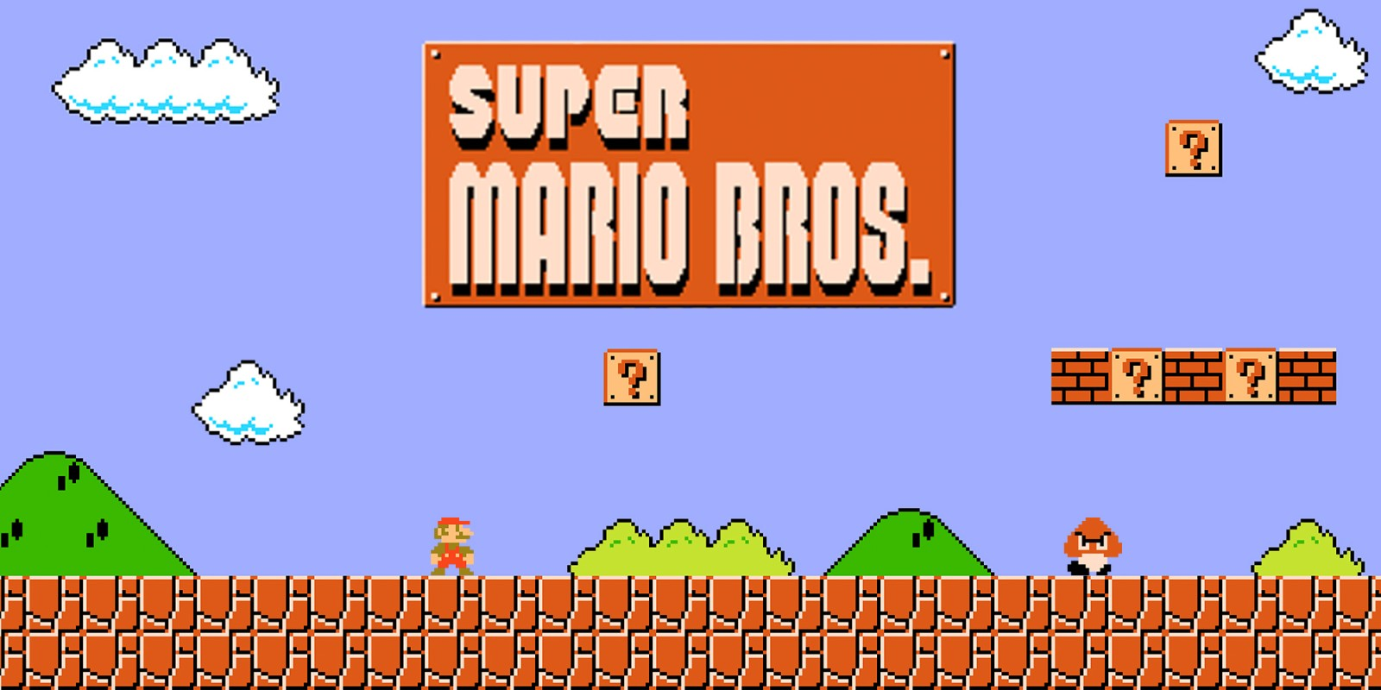
Case Study
Gameplay: https://youtu.be/w2NjUDfOp2o
Game Design Document: https://bit.ly/2sdUylb

Slide 6
Step 1: Read
Step 2: Reference
Read given GDD
Identify Game Genre
References given by client:
Highest Priority.
Do your own Research:
Mario is the definitive 2D Platformer
Look for other famous 2D platforming games like Super Meat Boy, Braid, Sonic, Megaman.
Platform: Nintendo Entertainment System (NES)
Number of Players: Max 2
Controls:
D-Pad to Move
A to Jump
B to Run/Use Special
Genre: 2D Platformer
2D: 2 Dimensional, Movement only in X/Y Plane
Platformer: The player controlled character must jump and climb between suspended platforms while avoiding obstacles.

Slide 7

Step 3: Breakdown
Break Game mechanics down into individual modules
2. Comparative analysis with reference game mechanics
3. Ensure common genre standards are replicated
Movement
8 Directional Movement using the dpad
B button makes Mario run faster.
Jumping
Press A to jump
Running makes mario jump further
Time your jumps to clear obstacles
Attacking
Can kill most enemies by jumping on top
Fire Mario can shoot fireballs by pressing B
Lives System
Small Mario = 1 Life
Fire/Super Mario = 2 Lives
100 coins/ 1UP = 1 Extra Life
Total 5 Lives (Game Over)
Timer: Goes to 0, Player Dies
Responsive Movement and Jumping Mechanics
Level Design uses the mechanics to their extent (have variety)
Allow the player to play at their own pace
Have consistent rules
New Mechanics should be introduced safely
Difficulty should increase as game goes on

Slide 8
Step 4: Exploit
Confirm Positive Flow
Consider Edge Cases
Some common approaches
Does one mechanic directly/indirectly affect the working of another? Ensure both work in conjunction.
Does the mechanic work correctly repeatedly?
Does the mechanic still work if used in an unintended way?
Does interrupting the mechanic once resets its usage?
…...and countless others.
Confirm Positive Flow for each individual Mechanic, is it working as required?
If not:
Why?
What other elements are affected?
Is it a glitch or a bug?
Every Mechanic is different and behaves differently according to the situation.
You just have to be creative
Let go of your Bias
Being a gamer can make you accept well known mechanics as is.
EXAMPLE: If it says double jump, It should only Jump twice, right? (WRONG)
Periodically, get others to test your game to find out your biases while testing

Slide 9
Step 5: Report
Report bugs/issues found following the template discussed before.
For Game Mechanic related bugs/edge cases, Add the solution as well. Following the GDD or a reference.
(Pro tip: Don’t feel bad if it’s not implemented)
Mechanics can always be improved, Feel free to add suggestions as well.

Slide 10


